Slide 1
Berkeley Database
Base de Datos Avanzadas
Instituto Tecnológico de Costa Rica
Leonardo Vargas, Catalina Días, José Viquez

Slide 2
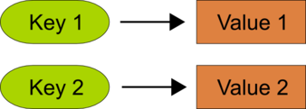
Why to love Berkeley db?
Key – Value Data Store
ACID complain
HA with replication
Java y C implementations
Additionally there is a XML Berkeley DB
Used as a library

Slide 3
Agenda
Get Berkeley Database for Java
Berkeley Database for Java
How to Connect to Berkeley DB?
Transactionality
Demo with HA, and Replication.
App architecture
Conclusions
Questions

Slide 4
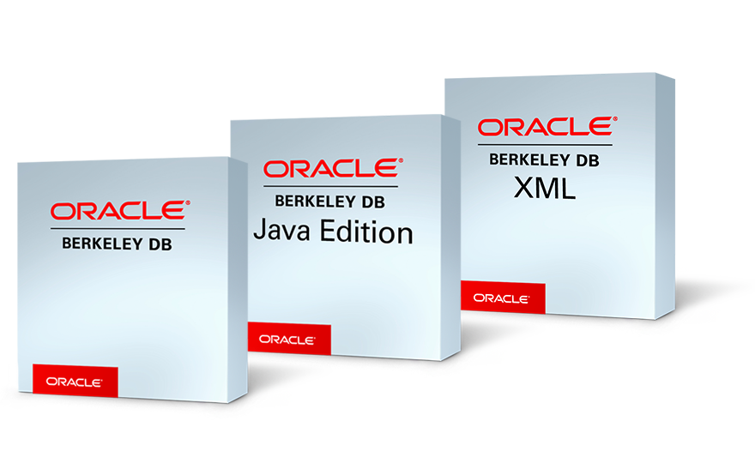
Get Berkeley database for java
Where to download?
From Oracle
Link: https://www.oracle.com/database/technologies/related/berkeleydb-downloads.html
You need an Oracle user to download the database

Slide 5
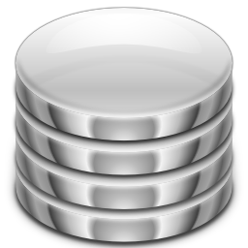
Berkeley database for java
It is a Server?
It is a library?
Where in the memory is located the database?
What is the Berkeley DB jar?
Je-7.5.11.jar
Is there any url connection as in RDBMS?

Slide 6

Berkeley interaction components
EntityStore
PrimaryIndex
SecondaryIndex

Slide 7

Berkeley DB Operations
Operations
Put → index.put(value) → Remember the value has the key
Get → index.get(key)
Delete → index.delete(txn, key)
What about queries?
Berkeley does not support SQL language or any query language.
The Query Language support of our applications is done through the API SpelQuery

Slide 8
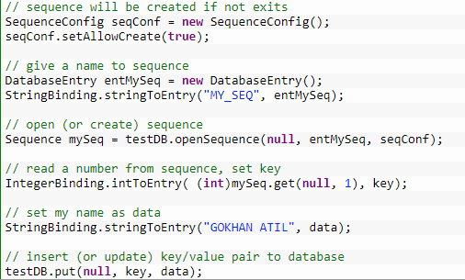

Persistence strategy for Berkeley db
Direct Persistence Layer API
Persistent Java Collections API
Byte Array based API

Slide 9

How to connect to Berkeley db?
Configure the Environment
It could be a normal environment or a replication environment
The environment should be transactional
It allows to create as well

Slide 10
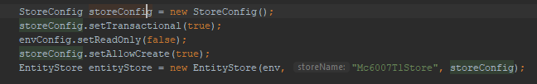
How to connect to Berkeley db?
Configure the Store
The Store is the component that let us connect to the DB, and interact with it.
It should be transactional
It should be allowed to create
It should be not read-only

Slide 11
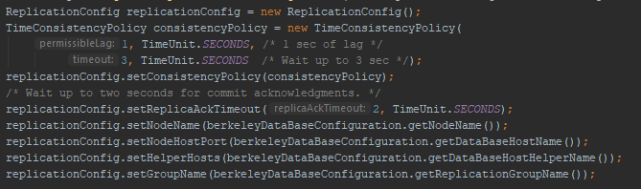
How to connect to Berkeley db - Replication?
What is the ReplicationConfig?
Is the component that configures replication.
Defines policies for consistency
Defines the node name, and port
Defines the Node Helper Host: this is special

Slide 12
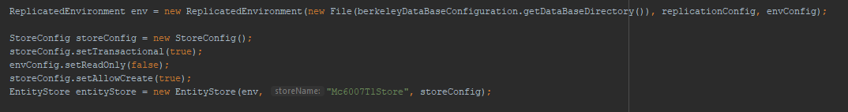
How to connect to Berkeley db - Replication?
What is the ReplicatedEnvironment?
Is the component that joins the ReplicationConfig with the environment configuration and let us replication Berkeley database.

Slide 13
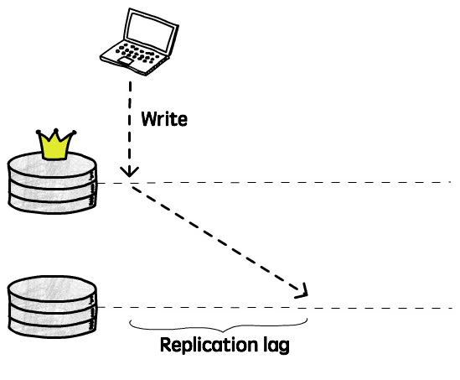
Berkeley db replication
Master and Replication nodes
Only the master can write, but all the nodes should support to write in case that the master fail
The replication nodes are read-only
If the master node fails another node should be designed as master, but the network must be greater than two nodes

Slide 14
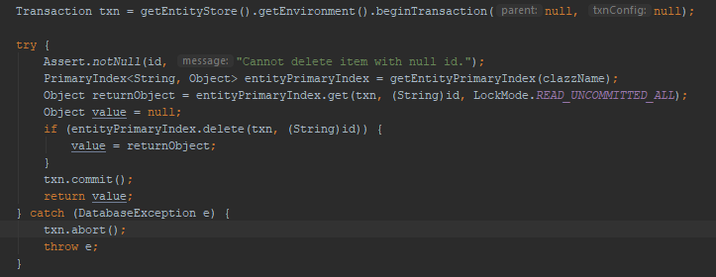
Berkeley database transactionality
The transaction is at the level of the environment (normal, replicated)
There is no any DML language, but you could use the method abort of the Transaction object to rollback the current transaction.

Slide 15
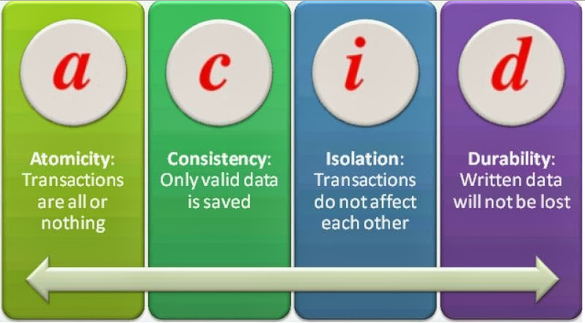
DEMO BERKELEY DATABASE FOR JAVA
Basic database operations
Replication
HA
ACID
Transactionality

Slide 16
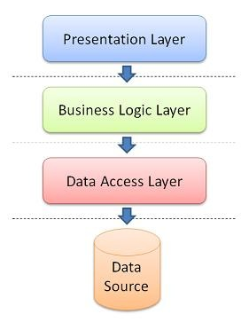
App Architecture
Three layer web app integrated with Berkeley DB
Repositories adapted to be used Berkeley DB and for DB connectivity.
Integrating Berkeley DB functionality with spring data components.
Key-Value → spring-data-keyvalue
Adapters → BerkeleyKeyValueAdapter

Slide 17
Berkeley replication schema
Master 6001
Replica 6002
Replica 6004
Replica 6003

Slide 18
conclusions
Berkeley database could be used as a library
Berkeley database supports replication
Berkeley database has some HA mechanism
Berkeley database supports ACID
Berkeley database is easy to use
Berkeley database is distributed as a library
Current implementation does not have a Query Language

Slide 19

qUESTIONS and answers

Slide 20
Thanks

